Slide 1
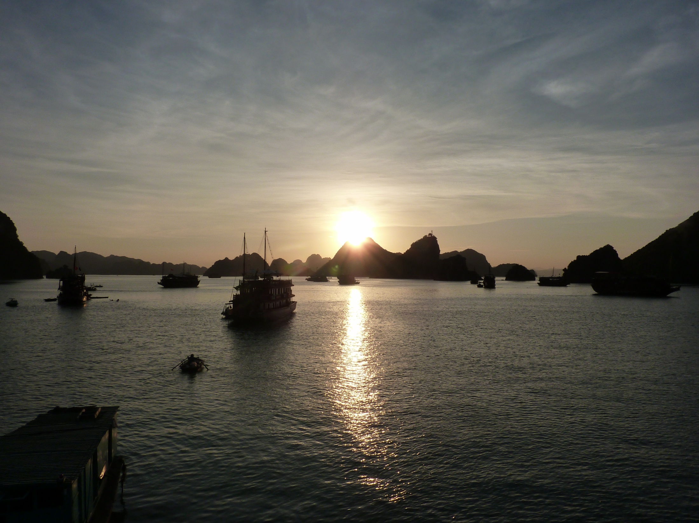
SHINE ON US

Slide 2
SHINE ON US
Earth and Heaven you created,
perfect and pure in every way
And man and woman in your image
to live and prosper in your way.
But we chose in our rebellion
to try and make it on our own:
A life of sin and self ambition
that made death our final home.

Slide 3
But your love was too strong
To allow all your children just to carry on
So you came in your love
To shine through our darkness
through your only Son.

Slide 4
Jesus, shine on all your children
And every day throughout the year.
Open up to us the way of lightness
Your love and mercy bright and clear,
your love and mercy bright and clear.

Slide 5
You could have kept your distance,
you could have stayed away.
You could have left us hopeless
in the darkness that we’d made.
You could have stayed in heaven
in the glory that is yours
Left us to our destruction
and the fate of broken laws.

Slide 6
But your love was too strong
To allow all your children just to carry on
So you came in your love
To shine through our darkness
through your only Son.

Slide 7
Jesus, shine on all your children
And every day throughout the year.
Open up to us the way of lightness
Your love and mercy bright and clear,
your love and mercy bright and clear.

Slide 8
Jesus, shine on all your children
And every day throughout the year.
Open up to us the way of lightness
Your love and mercy bright and clear,
your love and mercy bright and clear.

